Slide 1

Dr. Daulatrao Aher College of Engineering, Karad.
A
Project Presentation on
“Quick Mathematics Learning”
Presented by Under Guidance of
Mr.Pratik Arjun Chorage Miss.A.R.Kadve
Mr.Kamil M Rafique Bagwan
Mr.Abhishek Pandit Kalaskar
Mr.Gaurav Ramdas Mohite

Slide 2
Mini Project
Quick Mathematics Learning

Slide 3
Table of content
Problem Statement
Objective
Proposed work
Experimental setup
Expected outcome
Proposed system Digram
Scope of project
Conclsion

Slide 4
Problem Statement :
Many students are preparing for aptitude tests or entrence exams
and they have to search many books,online websites for different maths concepts,therfore in this project we construct a program
Which is very helpful to learn many short tricks to solve important concepts of mathematics along with a small test based on that concepts.

Slide 5
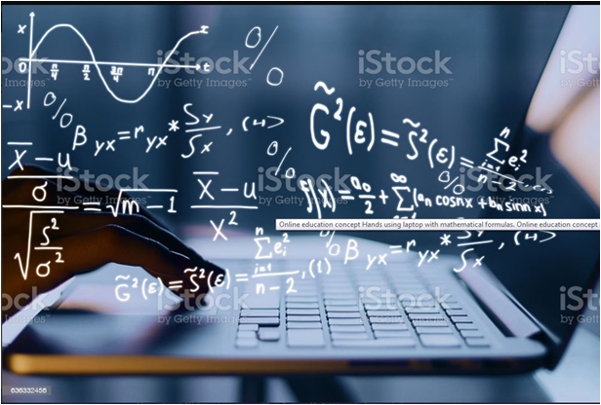
Objective
To make mathematics learning simple and
effective using technology.
To learn multiple important concepts at
one place.
To Learn short tricks for solving math
examples in less time.

Slide 6
Proposed work
Initially construct a program that give user two choice of learning and test.
In learning section it gives explenation of each concept with solved example of each.
In test section it conduct a small MCQ test on that concepts.
After submiting test it displays marks of the test and answers of all questions.

Slide 7
Experimental setup:
Hardware requirement | Software requirement
Intel core i3 or above microprocessor | Visual studio 2017 community
2gb of ram
55 GB of free space in the hard disk

Slide 8
Expected Outcome
It gives the output as the mark of MCQ test
conducted and solution of each example at end
of the test.

Slide 9
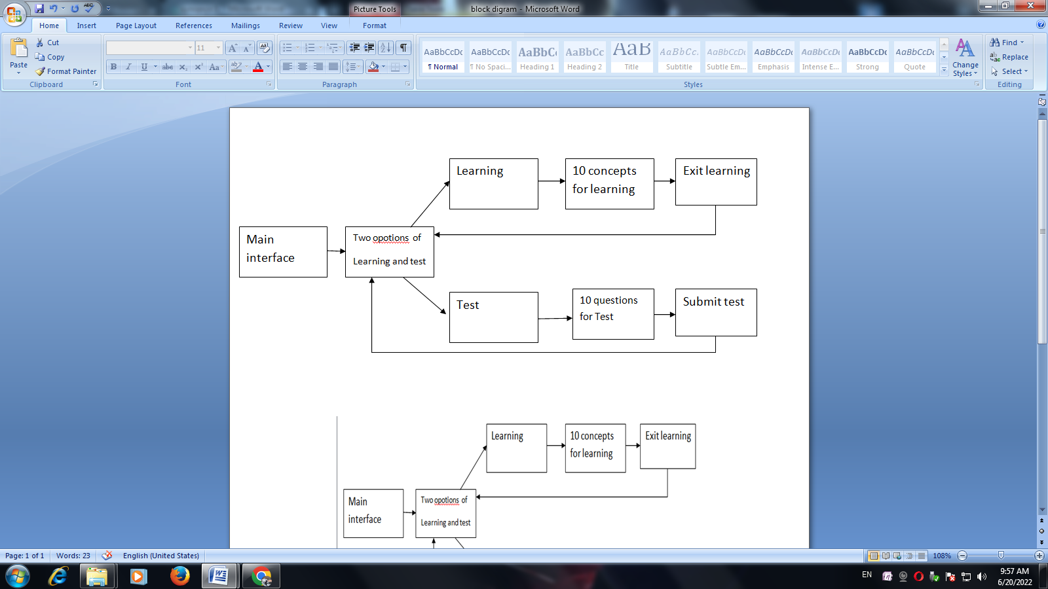
Proposed system diagram:

Slide 10
Scope of the Project
This project can be used by the school and college students to learn different maths concept in minimum time.
It can also be used by teachers to check the maths concept of
students in the form of the small and effective test.

Slide 11
Conclusion
Here we conclude that a Quick mathematics learning system
is a software that will help us to improve our math concepts
in less time using technology.

Slide 12
a
Thank you…

